Slide 1
Cropland detection in the Andes
Jose I. Ochoa
Geography Graduate Group
UC Davis
February, 2018

Slide 2
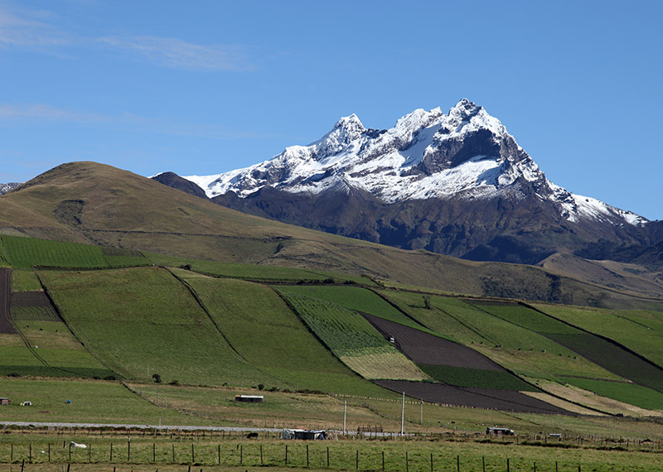
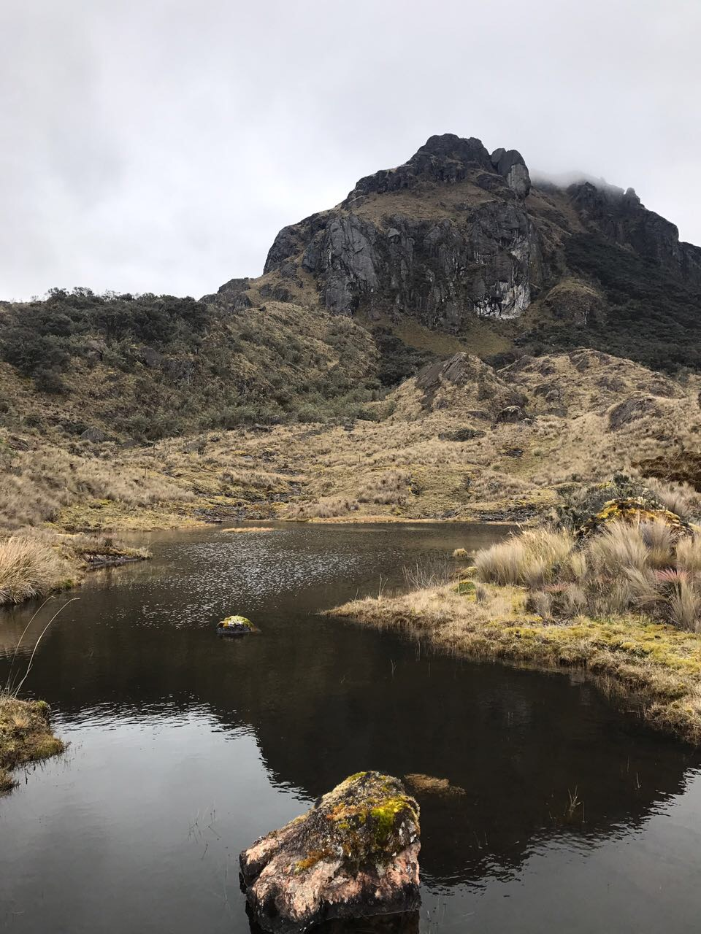
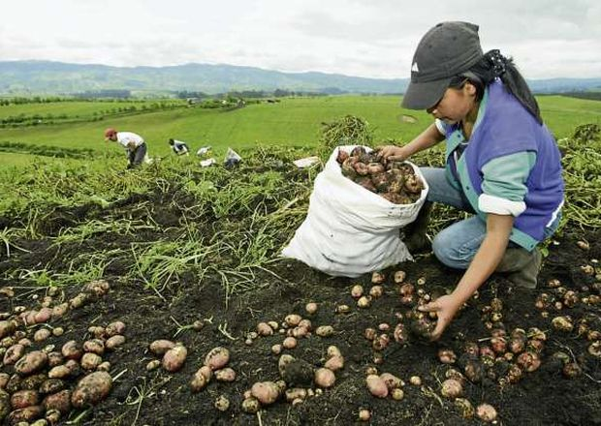
Problem, justification
Cropland detection in the Andes UC Davis
Why do we care about this
Agriculture, cropland expansion
Ecosystem services deterioration
Water retention, hydrological regulation
Source: tren Ecuador, http://trenecuador.com
Source: redepapa, https://redepapa.org

Slide 3
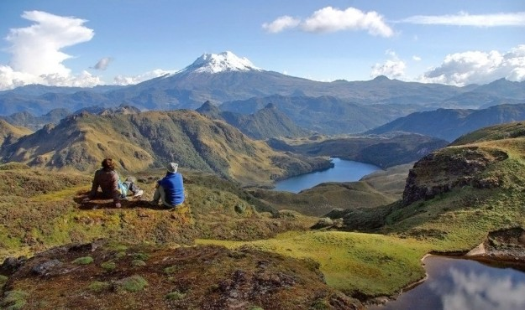
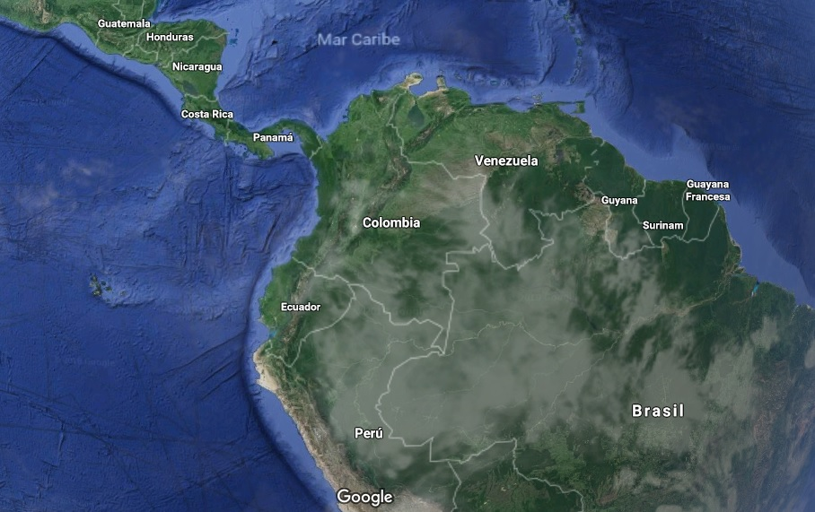
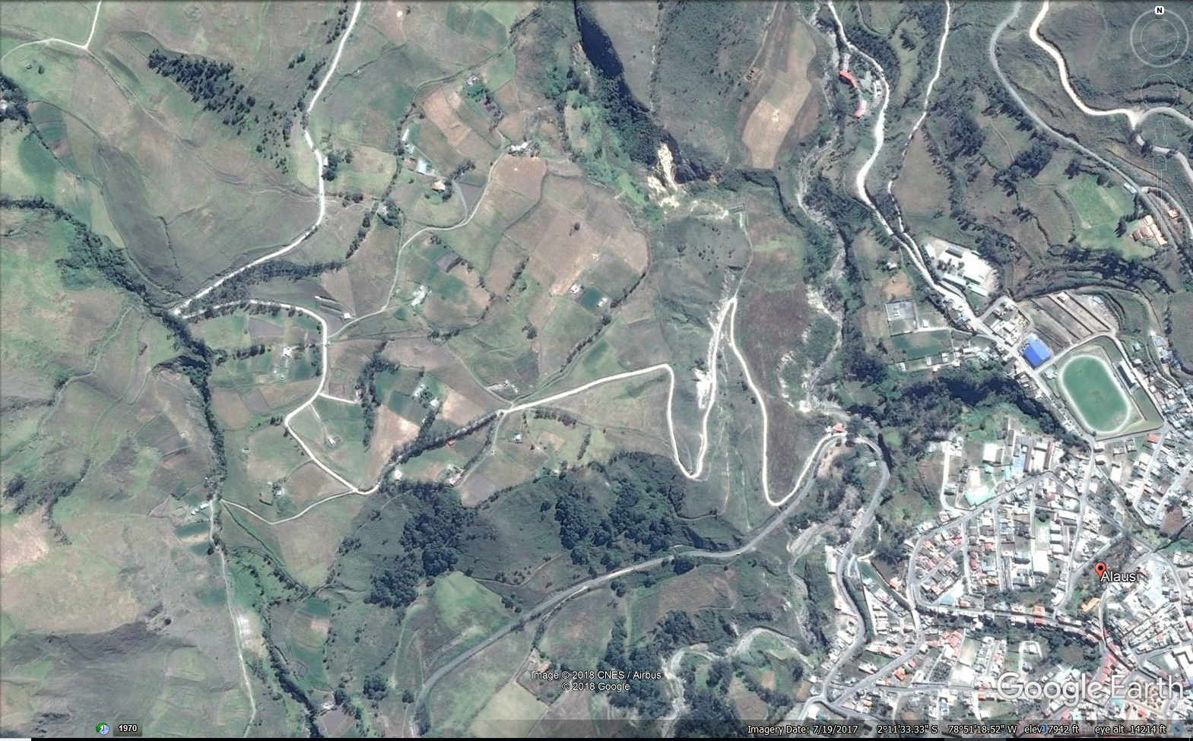

Cropland detection in the Andes UC Davis
Objective, study area
Predicting land use at no sampled geographical locations
Andes, 3500 meters above the sea level (tree line – snow line)
Andean region of Ecuador, South America
Source: Google Earth

Slide 4
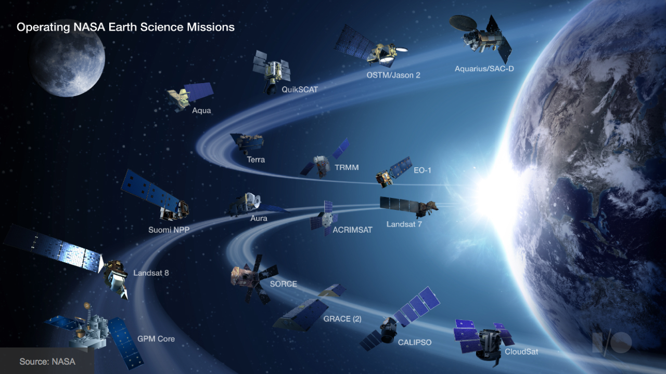
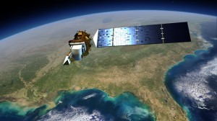
Cropland detection in the Andes UC Davis
Sources and methods
cloud-screening, composites
Remote sensing datasets → spectral information as predictor space
Spectral bands: VIS-NIR- SWIR-Thermal
Machine learning methods (random forest)
Training data (visually interpretated high resolution imagery)
Source: NASA

Slide 5
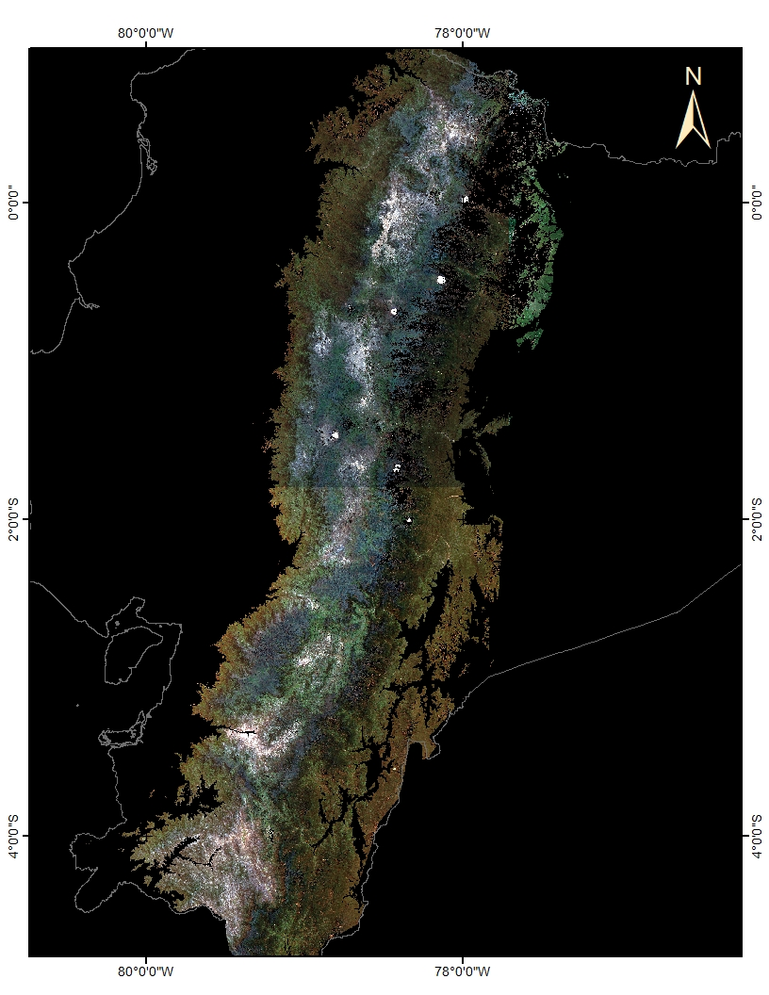
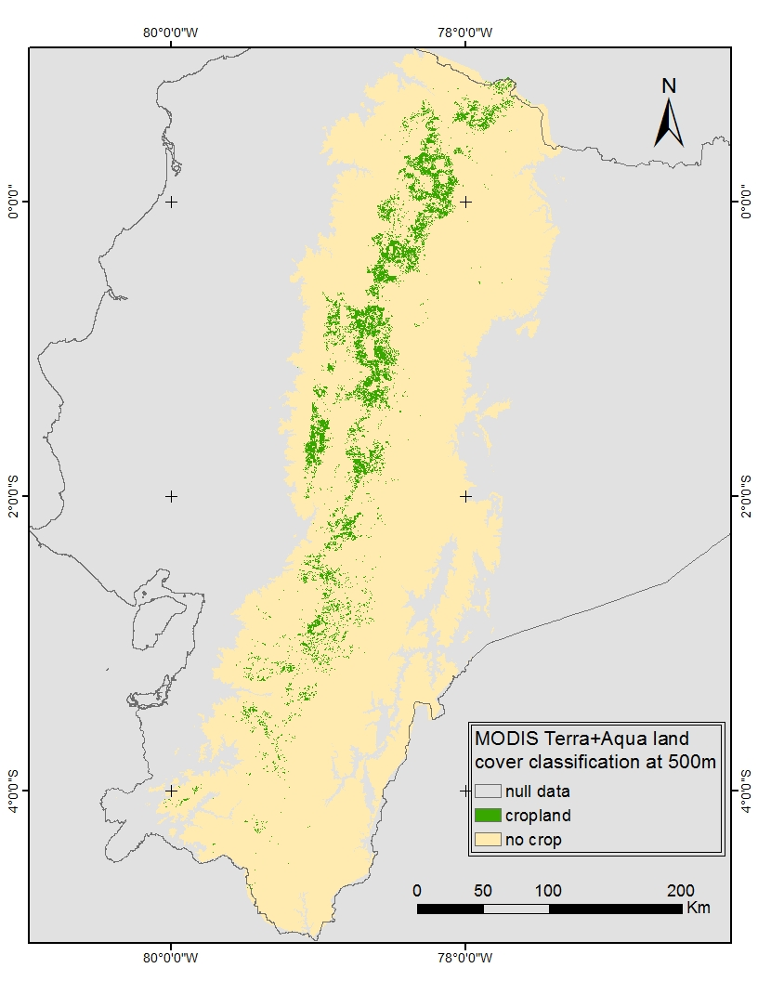
Results
Cropland detection in the Andes UC Davis

Slide 6
Thank you
Further contact
Jose Ochoa (Pepe)
Graduate student at Hijmans’ lab: biogeo.ucdavis.edu
jiochoa@ucdavis.edu

